Slide 1
Lexus digital Key Owners guide
Lexus connected services
05/06/24

Slide 2
Content
01 Page 3 - Activating the Digital Key Service.
02 Page 6 – Setting up you Digital Key.
03 Page 13 – Managing and sharing your Digital Key.
04 Page 15 – Customising the Digital Key range (Calibration).
05 Page 18 – Deleting your Digital Key using the Lexus Link+ App.
06 Page 19 – Deleting your Digital Key using the multimedia system

Slide 3
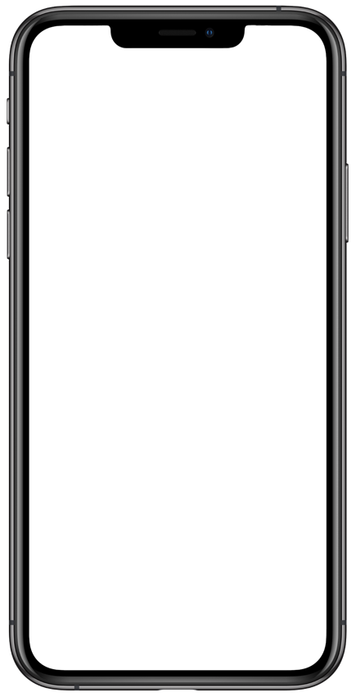
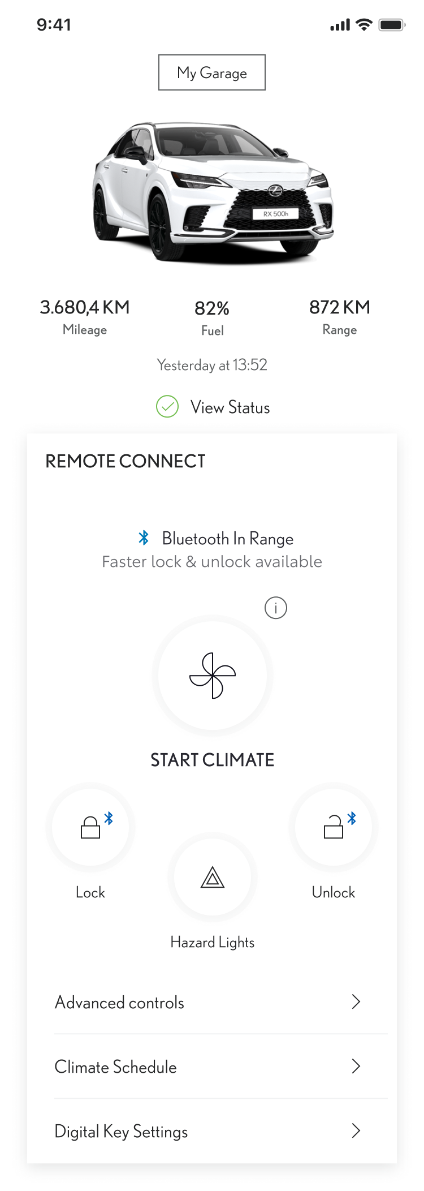
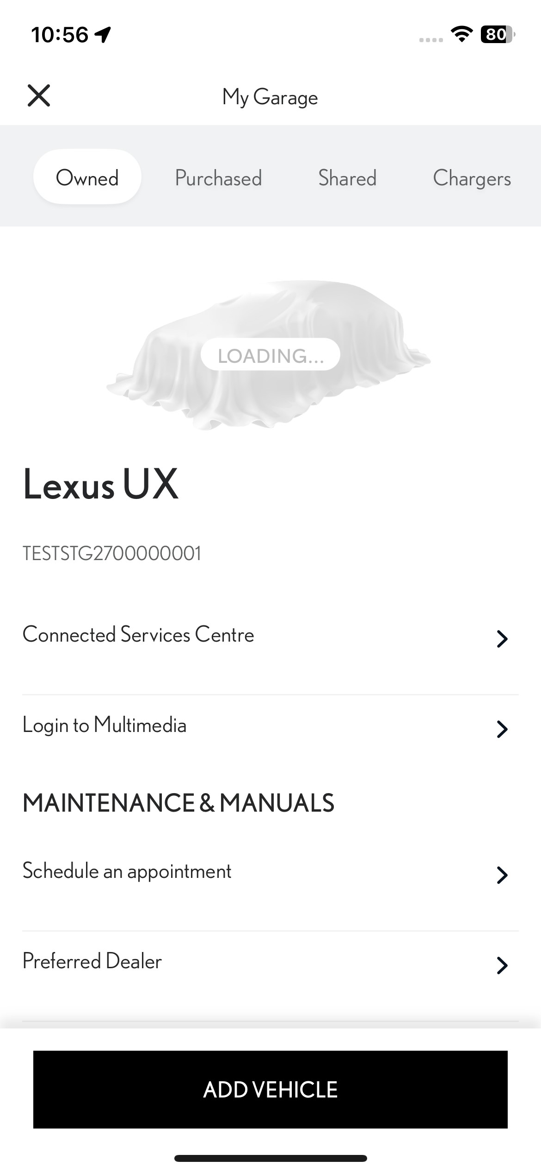
Digital key service activation
STEP 1 As an existing Lexus Link + app user with a Lexus account and having activated Standard Services, you will additionally need to activate the digital key services.
Tap on “My Garage”.
STEP 2
Tap on “Connected Services Centre”.
Note: If you are activating digital services for the first time, you can include the Digital Key service in your initial selection of services to activate.

Slide 4
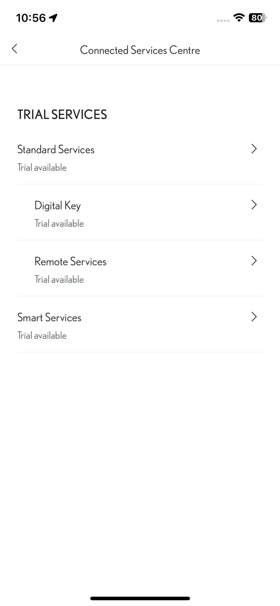
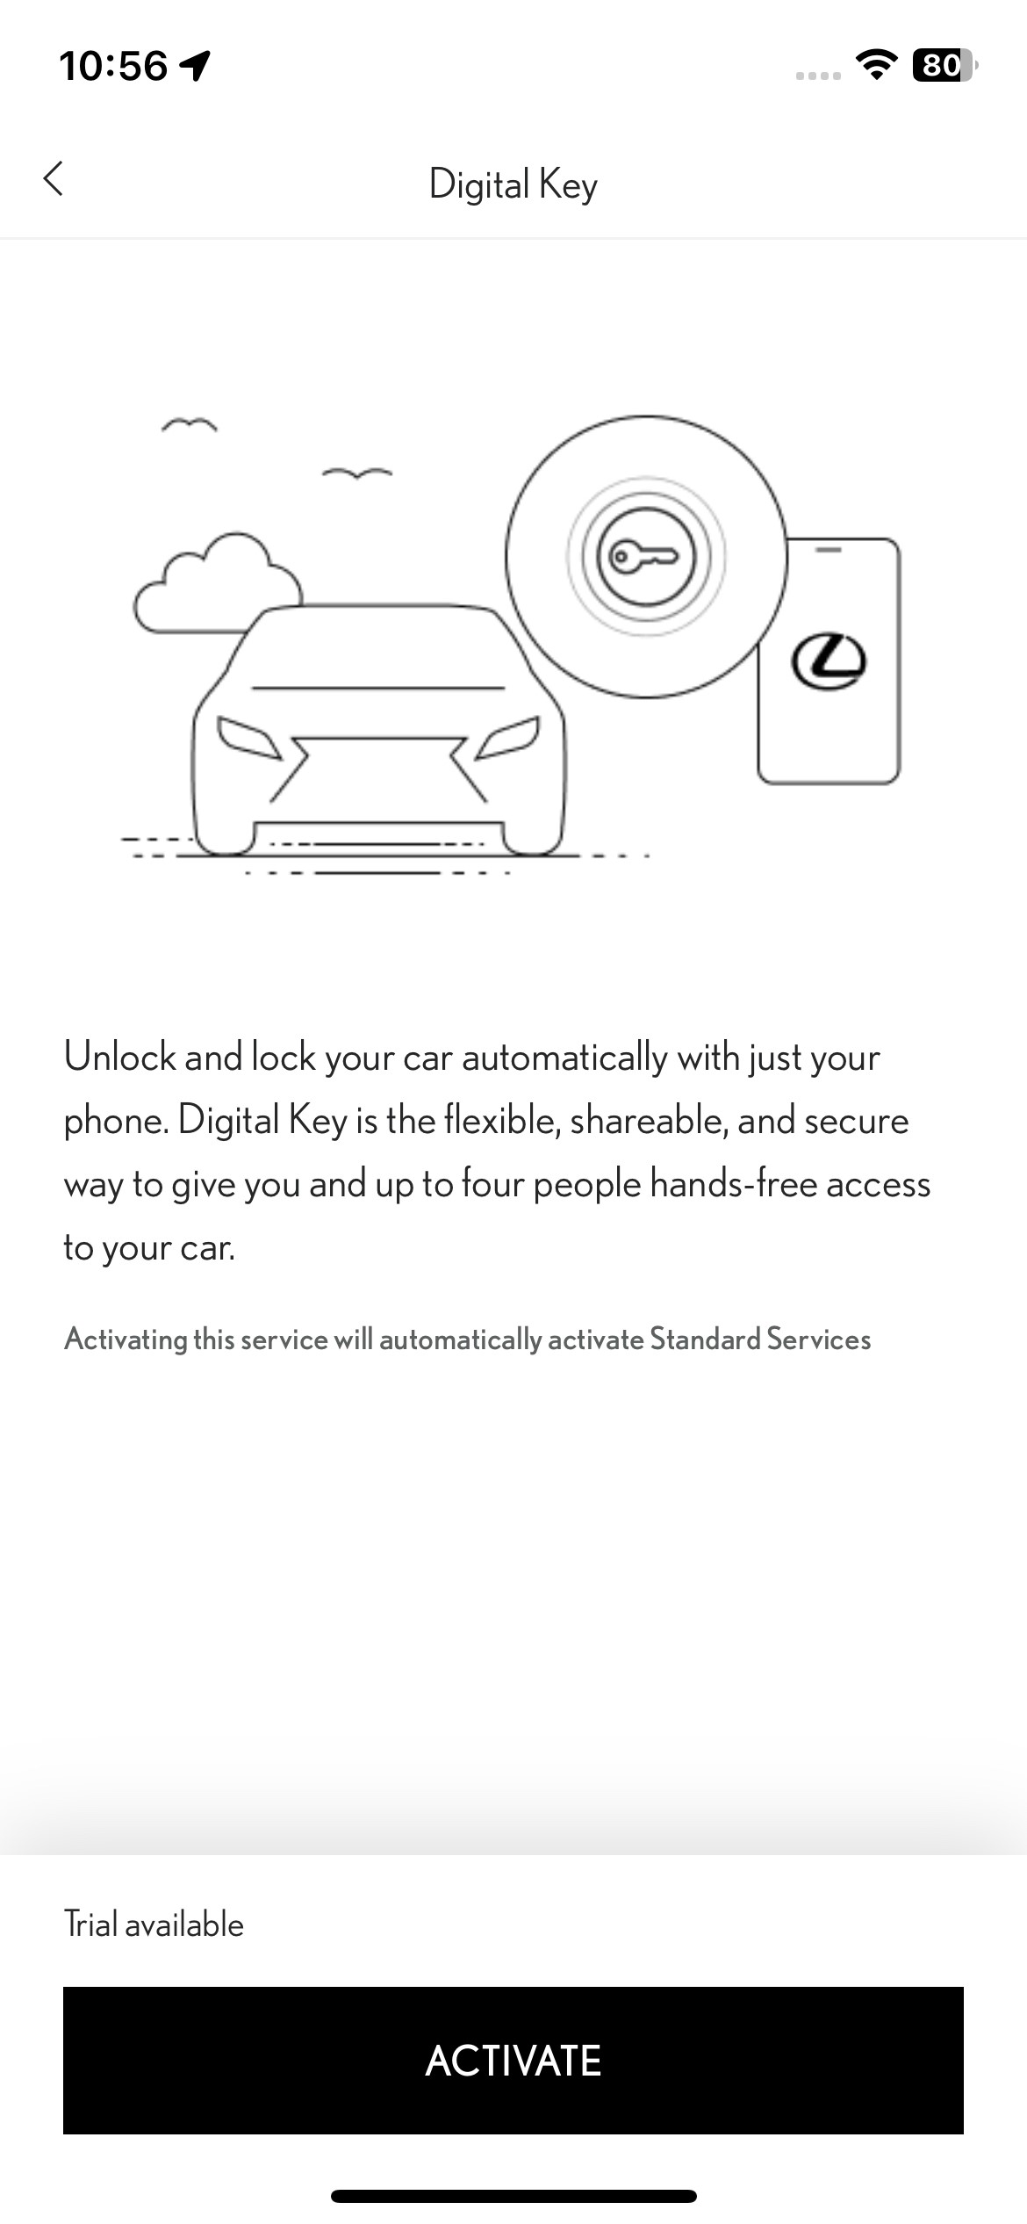
Digital key service activation
STEP 3 Tap on “Digital Key”.
STEP 4
Tap on “Activate” to activate the Digital Key Service*.
*Activation of Digital Key service will automatically activate Standard Services

Slide 5
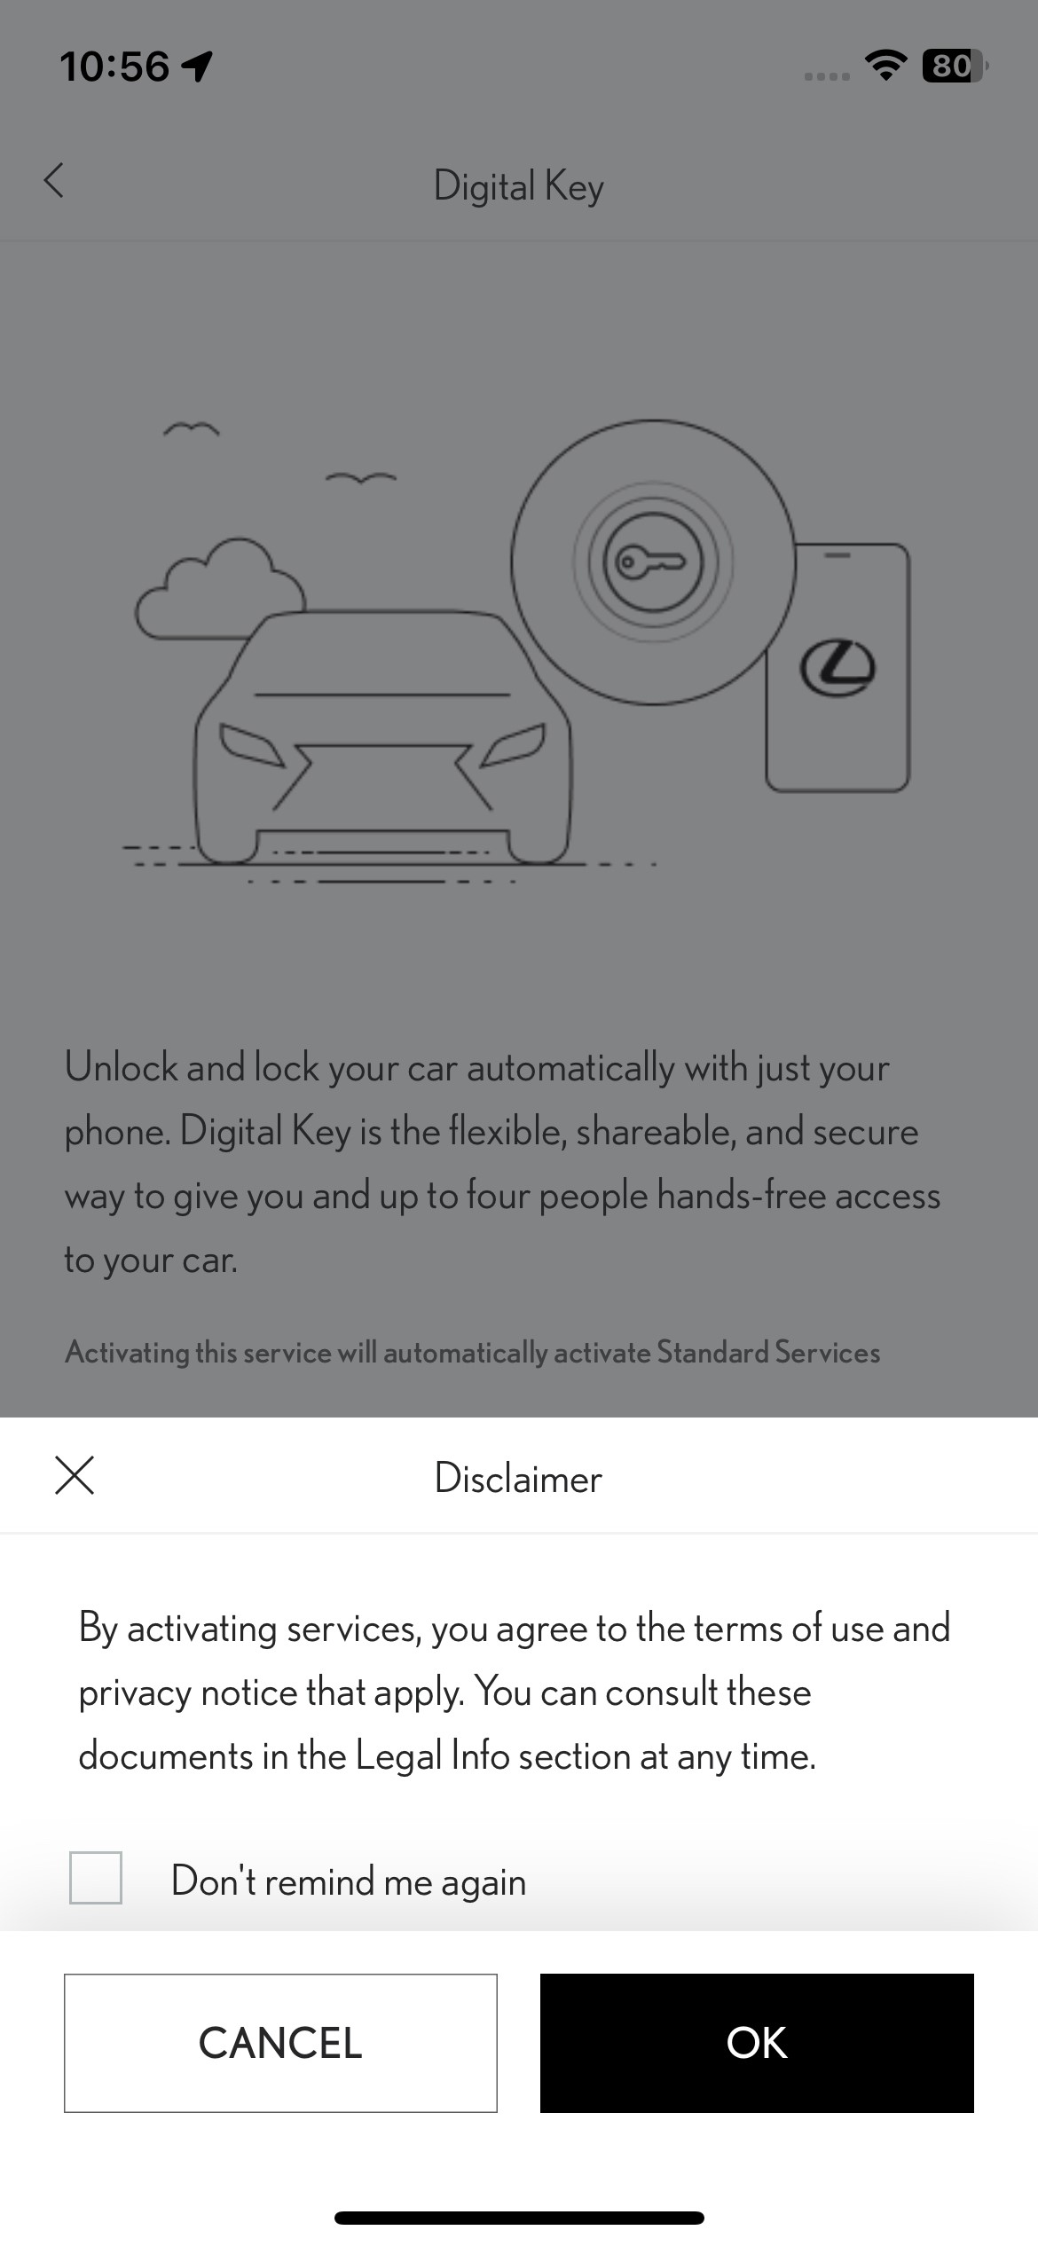
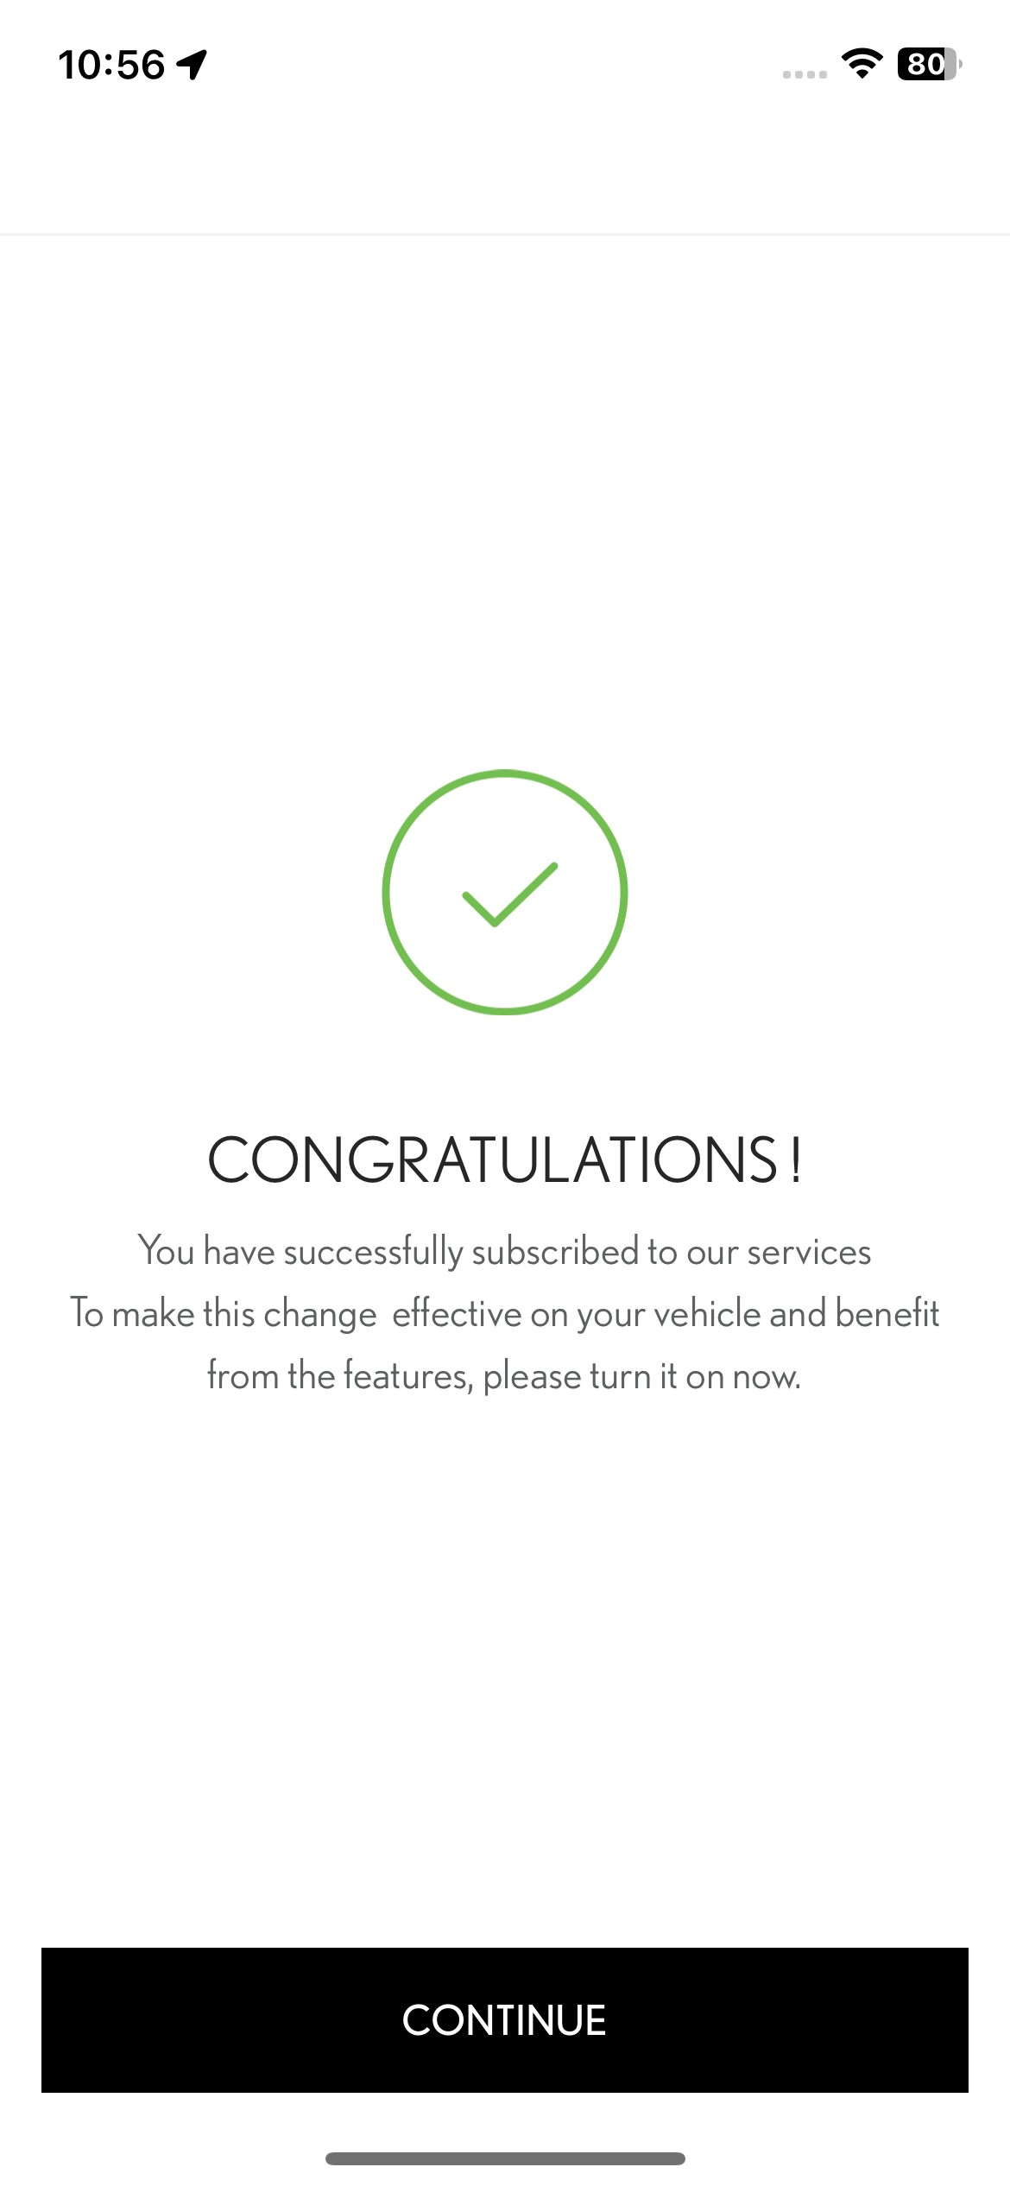
Digital key service activation
STEP 5 Tap on “OK” to confirm your activation of the Digital Key service.
STEP 6
The activation will be confirmed.
Tap on ”Continue” to set up the Digital Key.

Slide 6
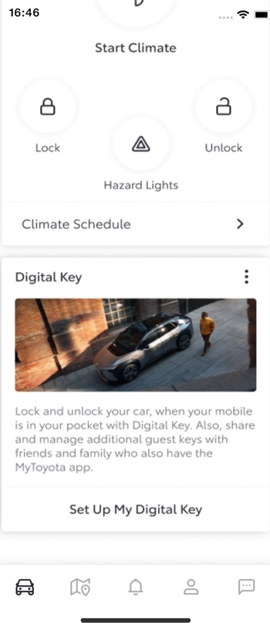
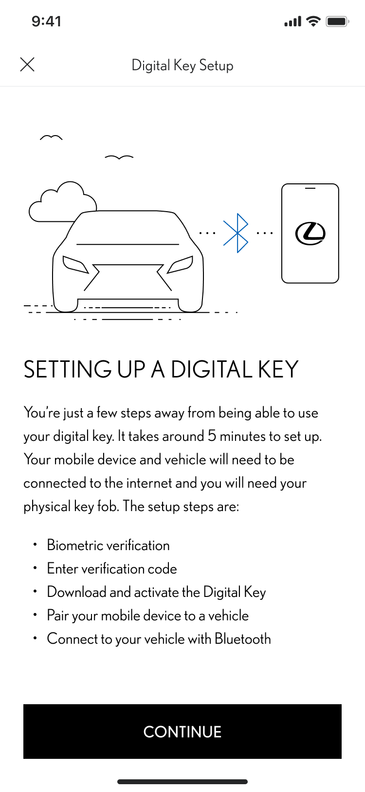
Setting up your digital key
STEP 1 From the Lexus Link + app home screen, tap “Set Up My Digital Key”.
STEP 2
The setup process will begin.
Tap “Continue”.

Slide 7
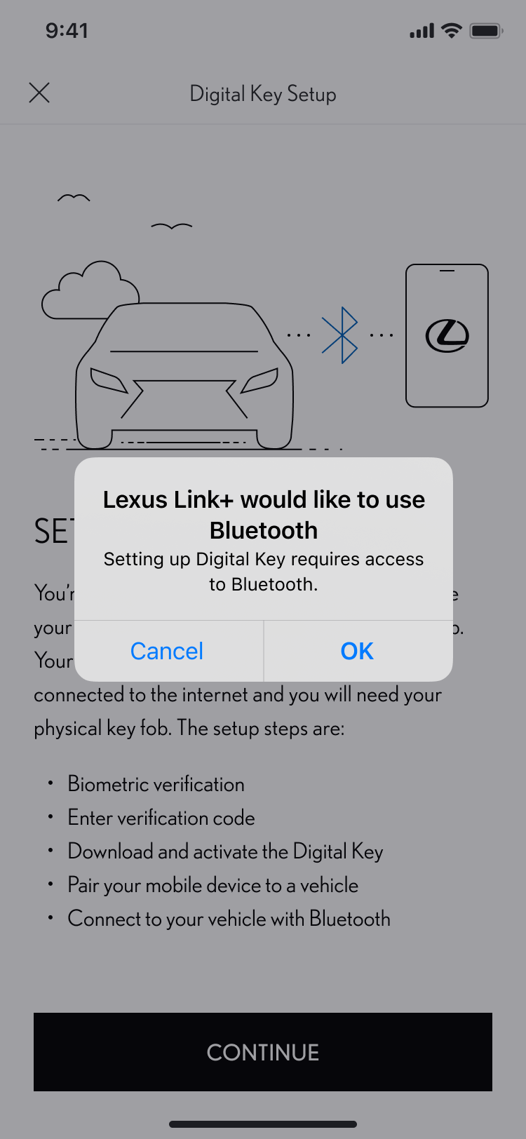
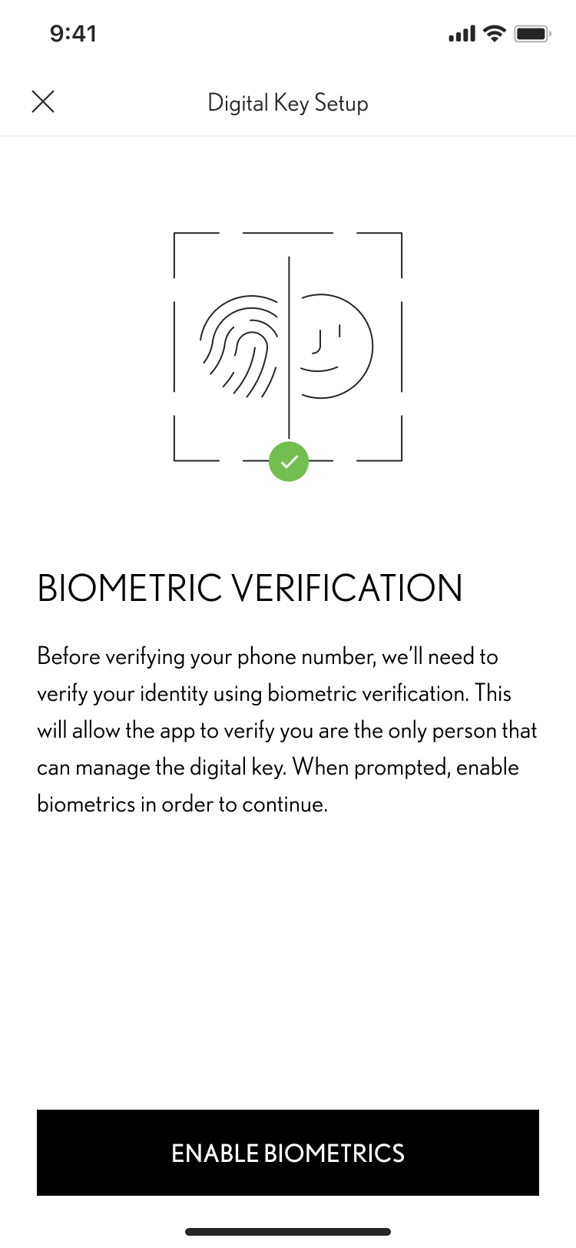
Setting up your digital key
STEP 3 Bluetooth access is required to setup Digital Key.
Tap Ok.
STEP 4
The app uses biometric verification to confirm your identity.
Tap “Enable Biometrics”.

Slide 8
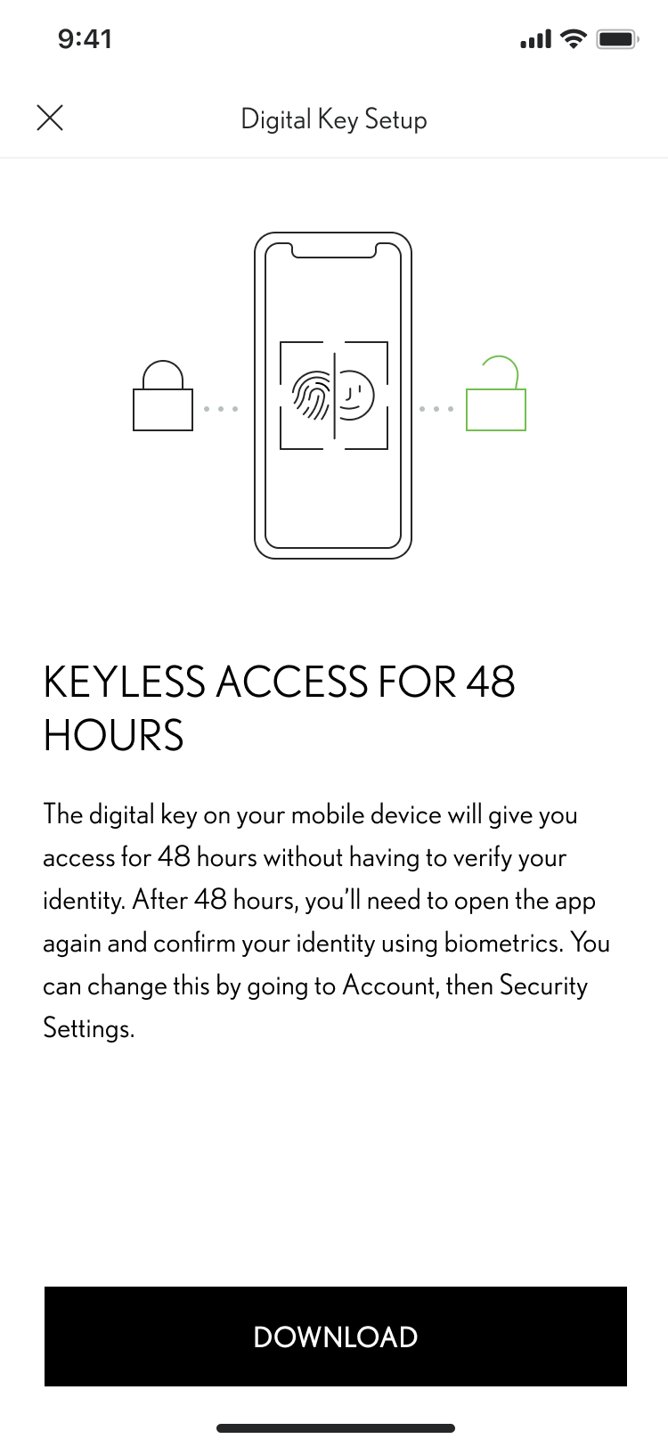
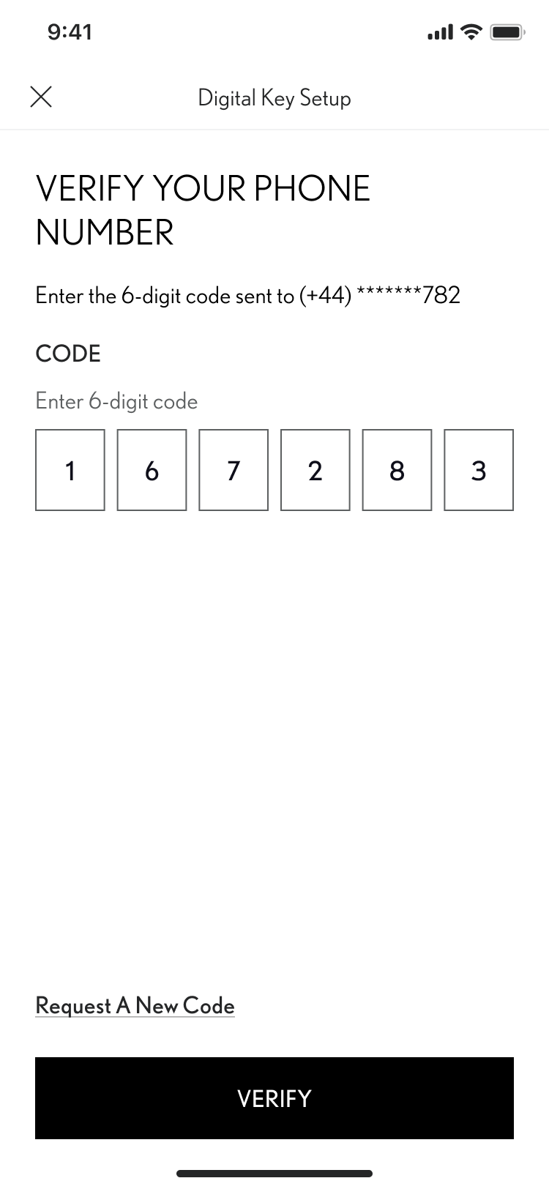
Setting up your digital key
STEP 5
A 6-digit code will be sent to the phone number associated with your app account.
Enter the code and tap Continue
STEP 6
For 48 hours, you can now gain keyless access without the need for verifying your identity.
Tap Next to verify.

Slide 9
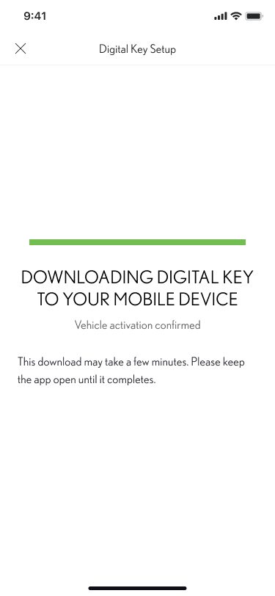
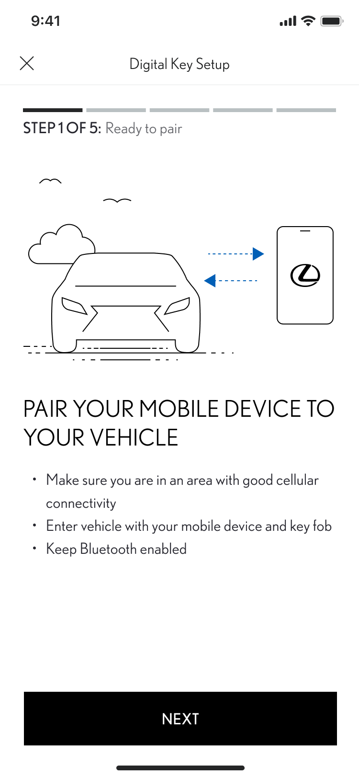
Setting up your digital key
STEP 7 Digital Key downloads automatically.
STEP 8
When pairing to your phone, make sure Bluetooth is enabled, you are in a strong cellular network area, and you have your key fob with you.
Tap “Next”.

Slide 10
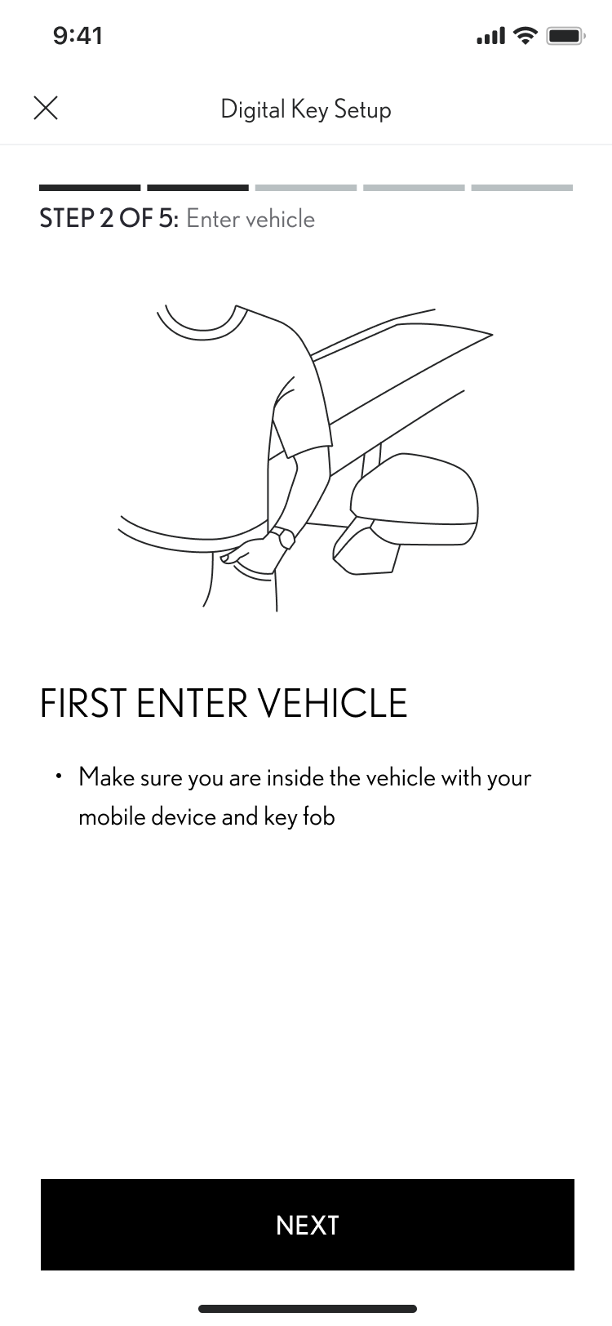
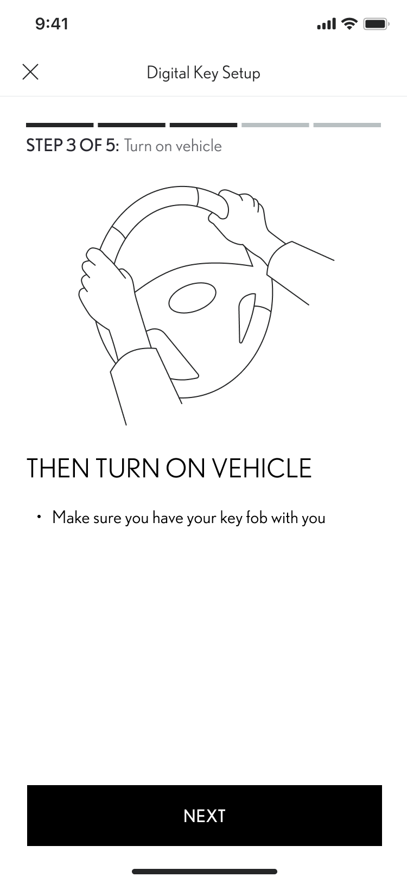
Setting up your digital key
STEP 9 Enter your vehicle making sure you have your key fob with you.
Tap “Next”.
STEP 10
Turn on your vehicle. Follow the onscreen instructions.
Tap “Connect To Vehicle”.

Slide 11
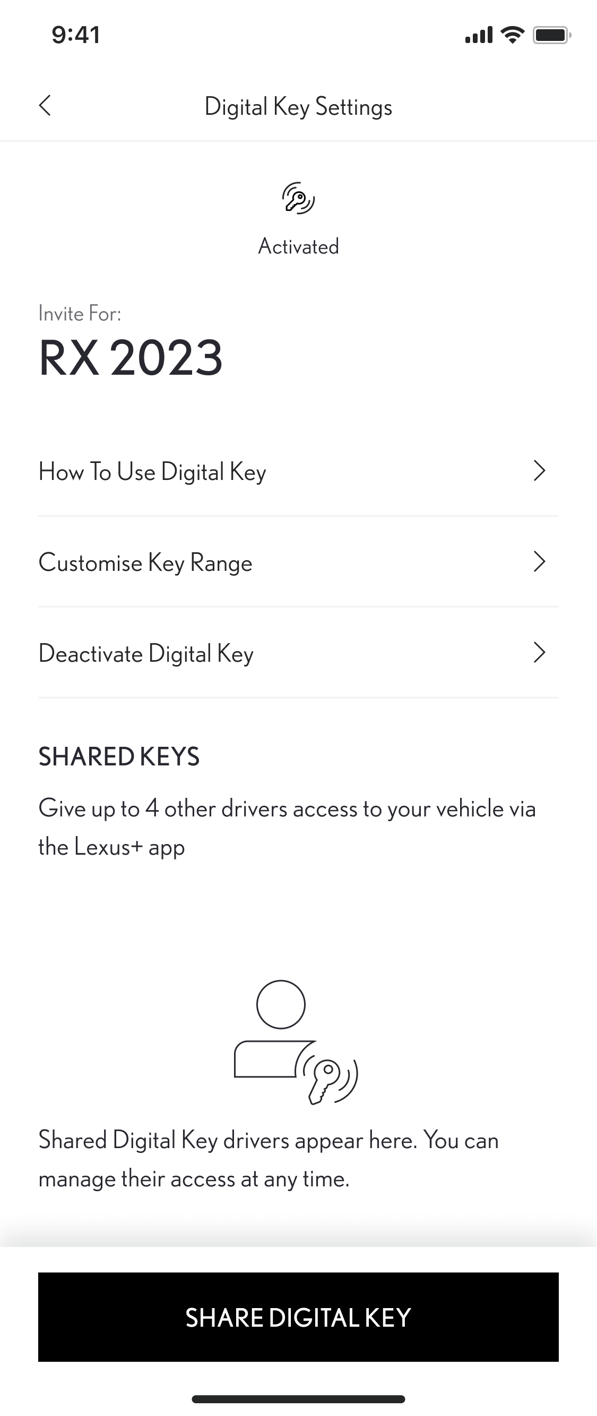
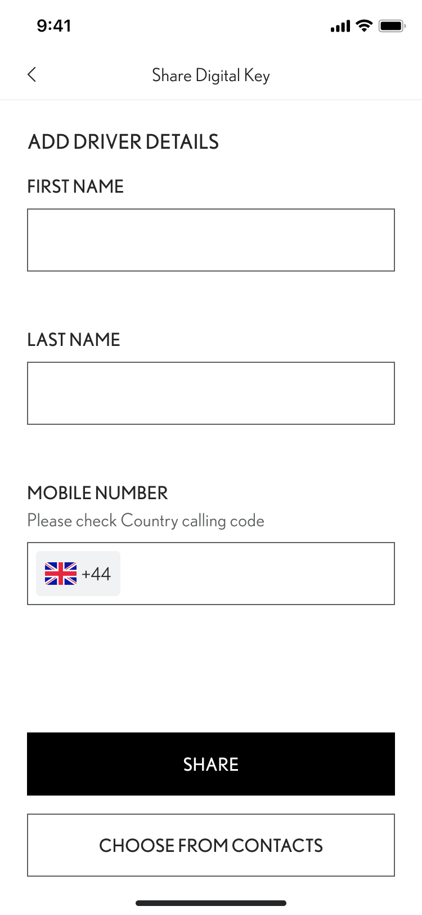
MANAGING AND SHARING Your digital key
STEP 1 Tap on “Share Digital Key”.
STEP 2
Add a person's details from your contacts or manually enter their information.
Tap “Share”.

Slide 12
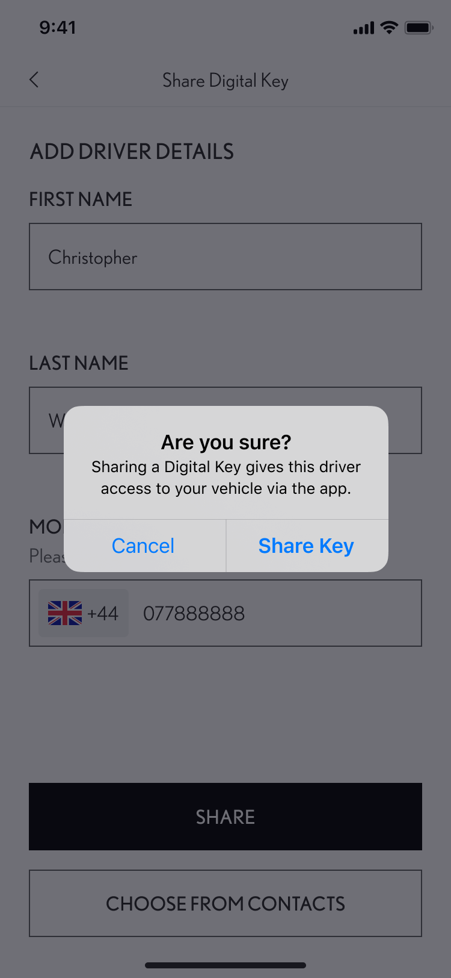
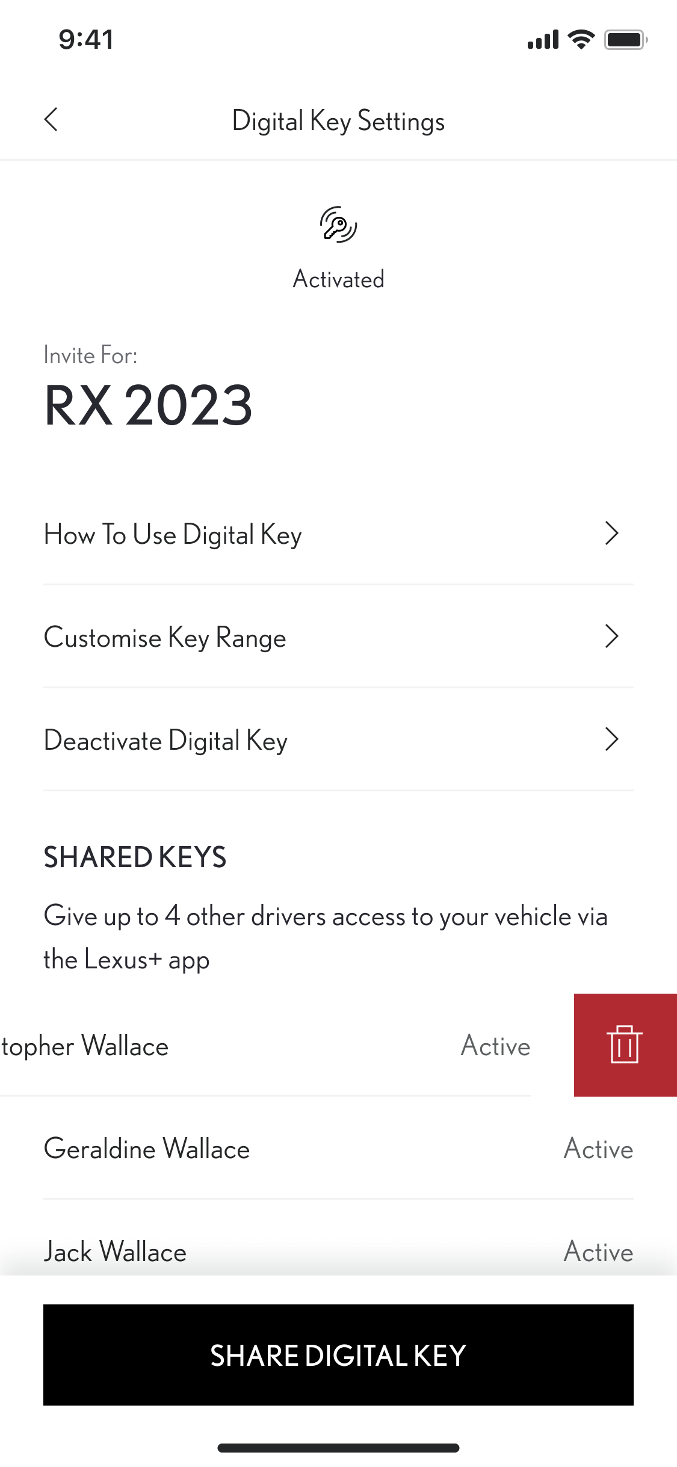
MANAGING AND SHARING Your digital key
STEP 3 To confirm that you wish to give access to your vehicle tap on “Share Key”.
STEP 4
To deactivate a shared key, swipe left on the person’s name.

Slide 13
Customising the digital key range (calibration)
STEP 1
If you feel that the Digital Key is not detected well enough while outside or inside the vehicle, it is possible to customize the range of detection of the key.
On the main screen scroll down and tap on “Digital Key Settings”.
STEP 2
Tap “Customize Key Range”.

Slide 14
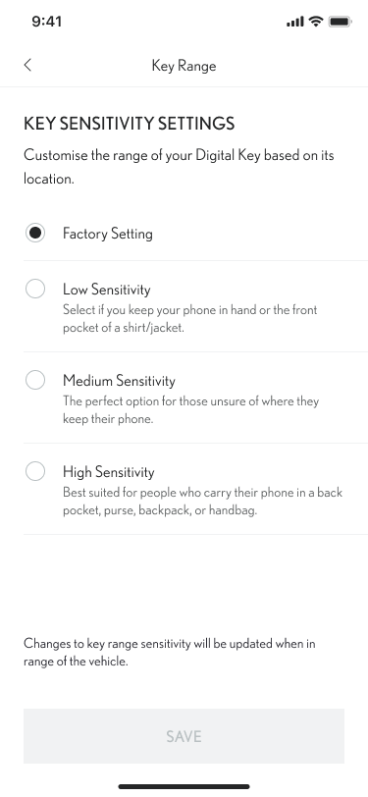
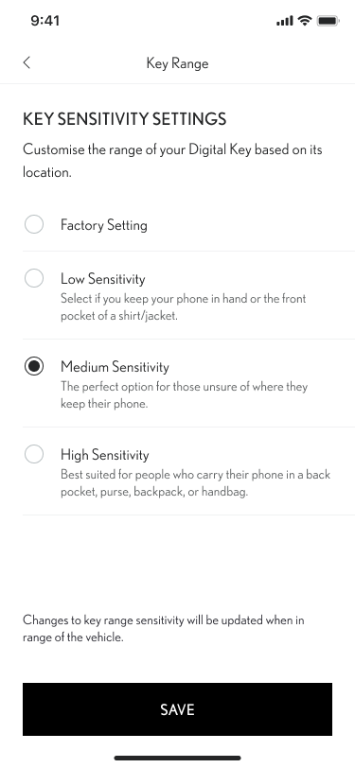
Customising the digital key range (calibration)
STEP 3
The Digital Key already has settings from the factory that should suit most drivers. What could impact the detection is how you carry your smartphone - Is it in a back pocket? In a purse? Or just carried in your hand?
You can choose between three different sensitivity levels depending on your personal habits.
STEP 4
Select your sensitivity level and tap on “Save”.
*Because of some limits with the car’s antenna and signal strength, some functionalities might not always work as expected. This can include unlocking, locking, and starting the car, especially if there are obstacles blocking the way

Slide 15
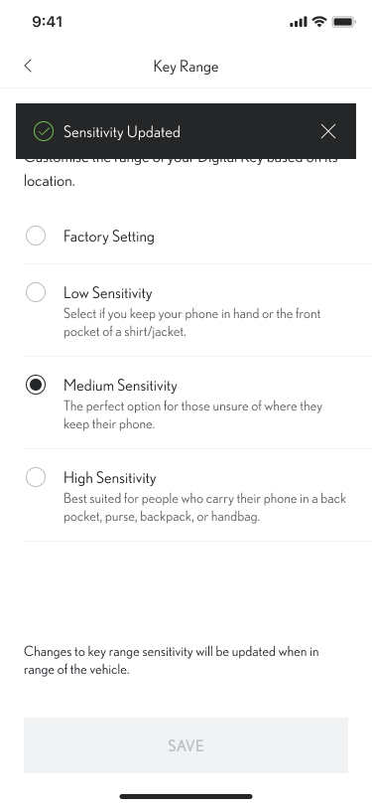
Customising the digital key range (calibration)
STEP 5
Confirmation of the Digital Key sensitivity update will be displayed.

Slide 16
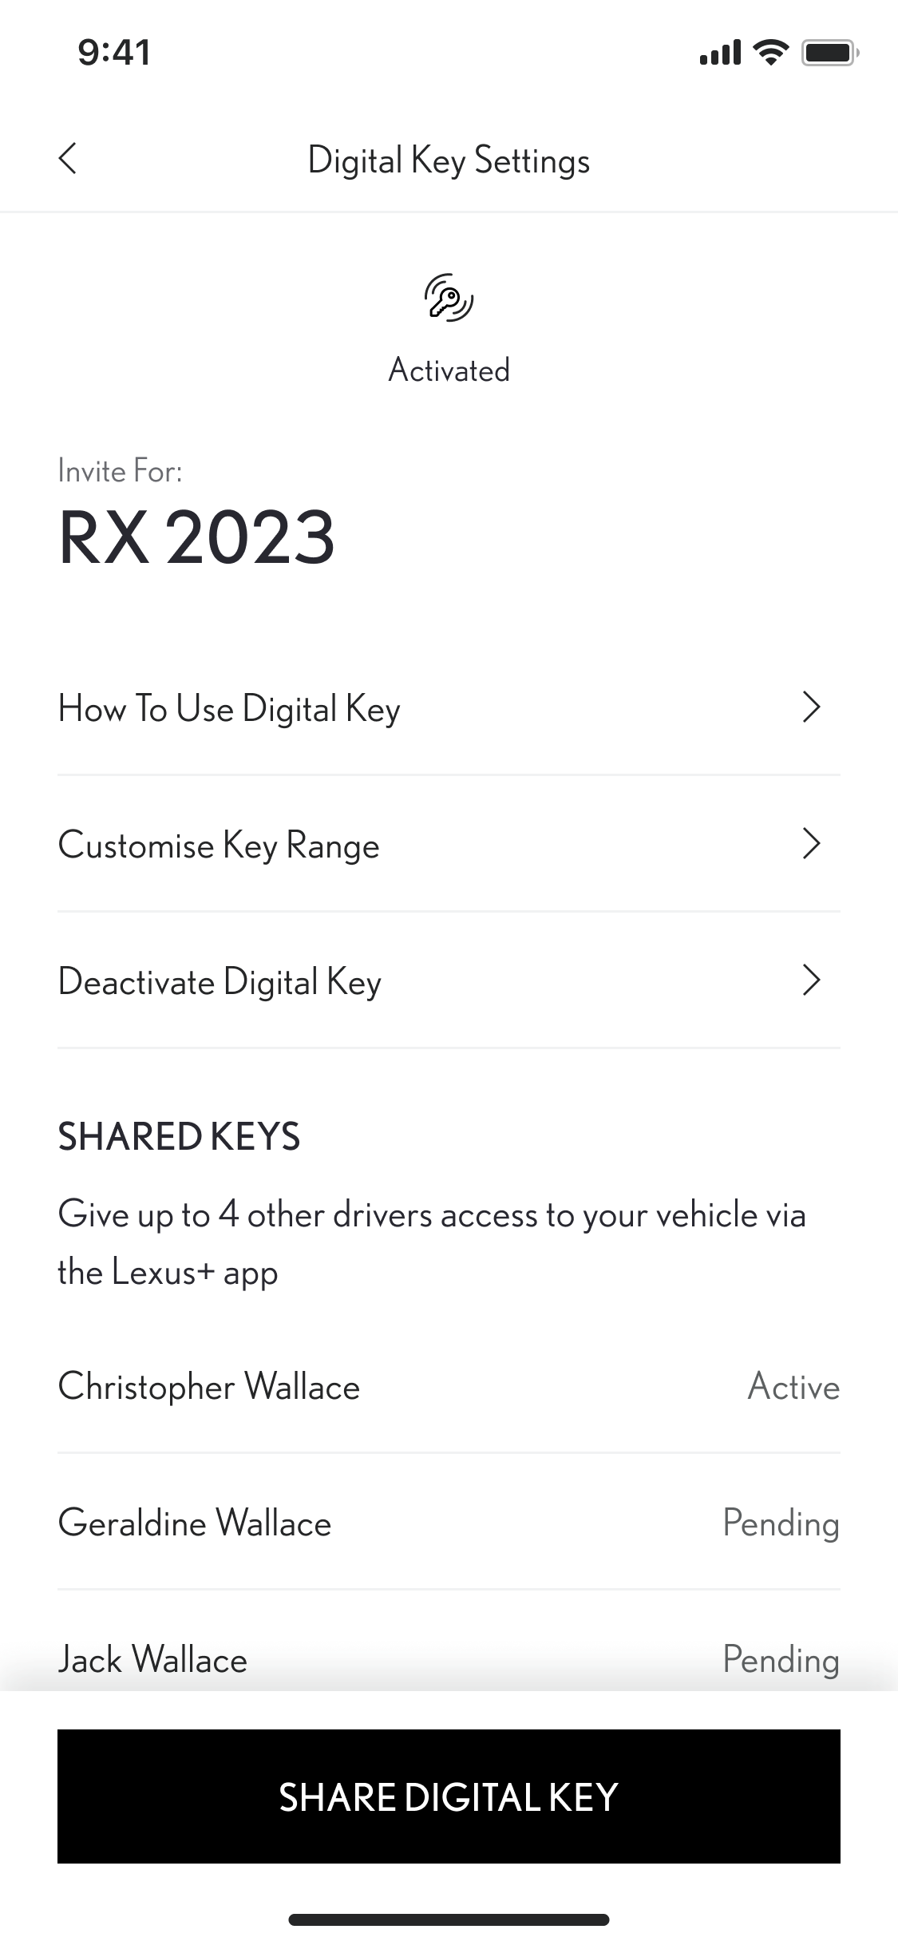
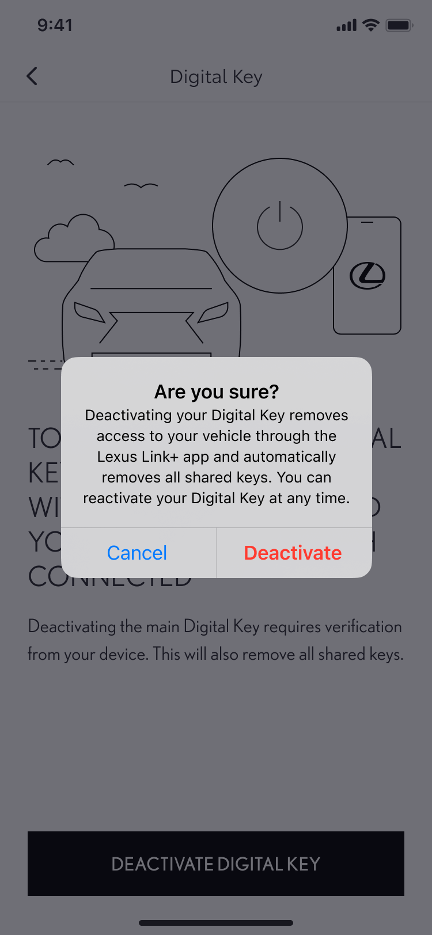
Removing your digital key – using the Lexus Link+ app
STEP 1
You can remove your Digital Key from either the Lexus Link + App, or from the navigation system.
This also removes ALL shared keys too.
To remove it using the Lexus Link + App, tap “Deactivate your Digital Key” in the Digital Key Settings.
STEP 2
Tap “Deactivate” to confirm that you wish to deactivate your digital key.
Note: The engine start function of the Smart Digital Key will not operate if your vehicle is equipped with an additional immobiliser device, and if the immobiliser key is not present inside the vehicle (same as the physical key).

Slide 17
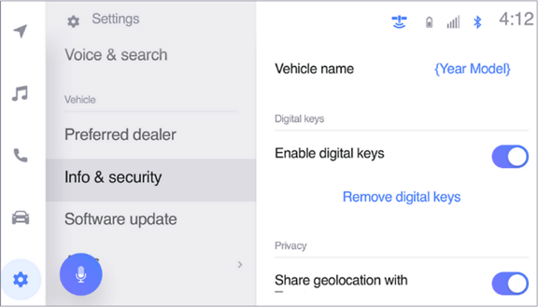
Removing your digital key – using the multimedia system
STEP 1 On the Multimedia main dashboard, go to the setting icon, then scroll down and tap on “Info & security”.
From here, you will be able to see in the Digital Key settings, if Digital Key is active.
STEP 2 Tap on “Remove digital Keys”, this will initiate the removal process.

Slide 18
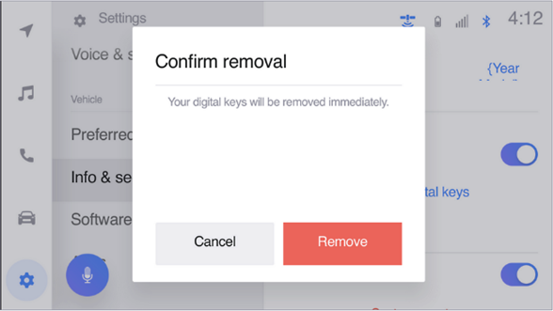
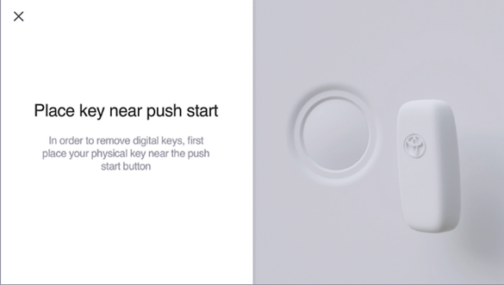
Removing your digital key – using the multimedia system
STEP 3 You must confirm your intention to remove your Digital Key*.
*When owner Key is removed all shared digital keys will be removed.
STEP 4 You will then be instructed to place the key fob on the Start button to proceed with the Digital key removal.

Slide 19
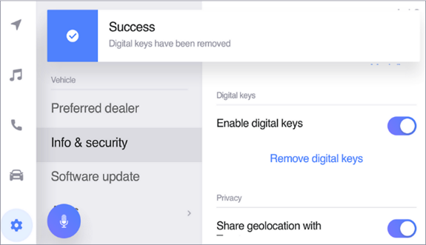
Removing your digital key – using the multimedia system
STEP 5 Shortly after, you will be informed that your Digital Key has been removed.

